Slide 1
Windows Users
User Security and Command Line

Slide 2
User Security
Passwords
Having secure passwords
Enforcing password policy
Permissions
Administrator Accounts
Unauthorized Users

Slide 3
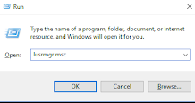
lusrmgr.msc
Press Windows + r to open the run command
Type in: “lusrmgr.msc”
You can use this to edit local users and groups.

Slide 4
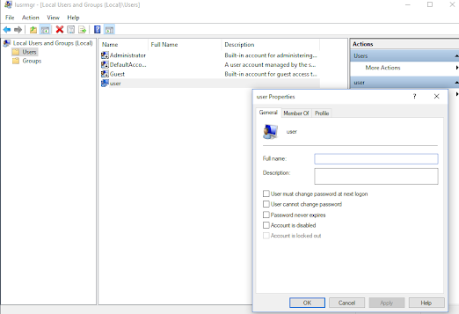
Users
Right click, “Add user” to add user
Right click on a user, and go to properties
Uncheck password never expires
Can disable/enable accounts
Disable Guest
Right click on user and press “delete” to delete a user

Slide 5
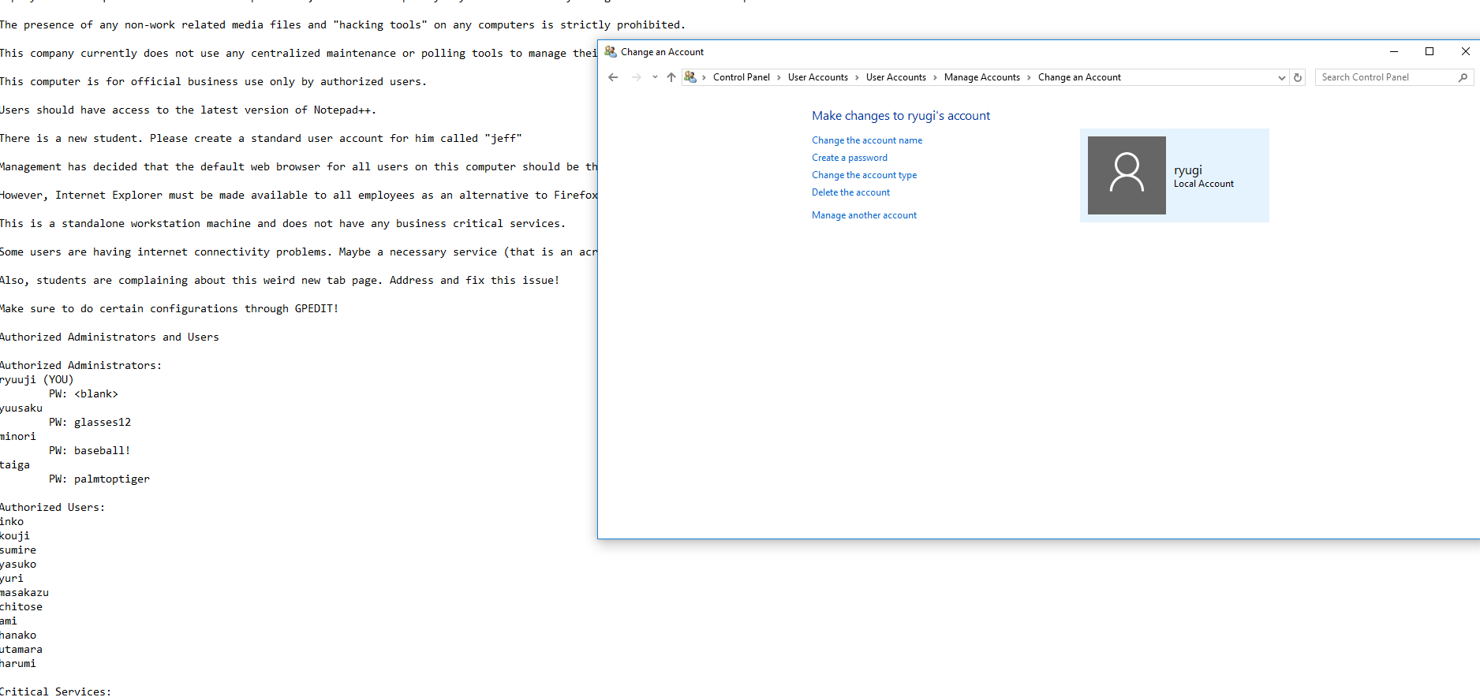
Users - Control Panel
Control Panel - User Accounts - User Accounts - Manage Accounts
Go through all of the users and make sure they have proper privileges or deleted if necessary
Make sure all admins have a password with a number/symbol
When in doubt replace all (except the main user (you)) passwords (admins and regular users) to CyberPatriot@Year Ex: CyberPatriot@2022

Slide 6
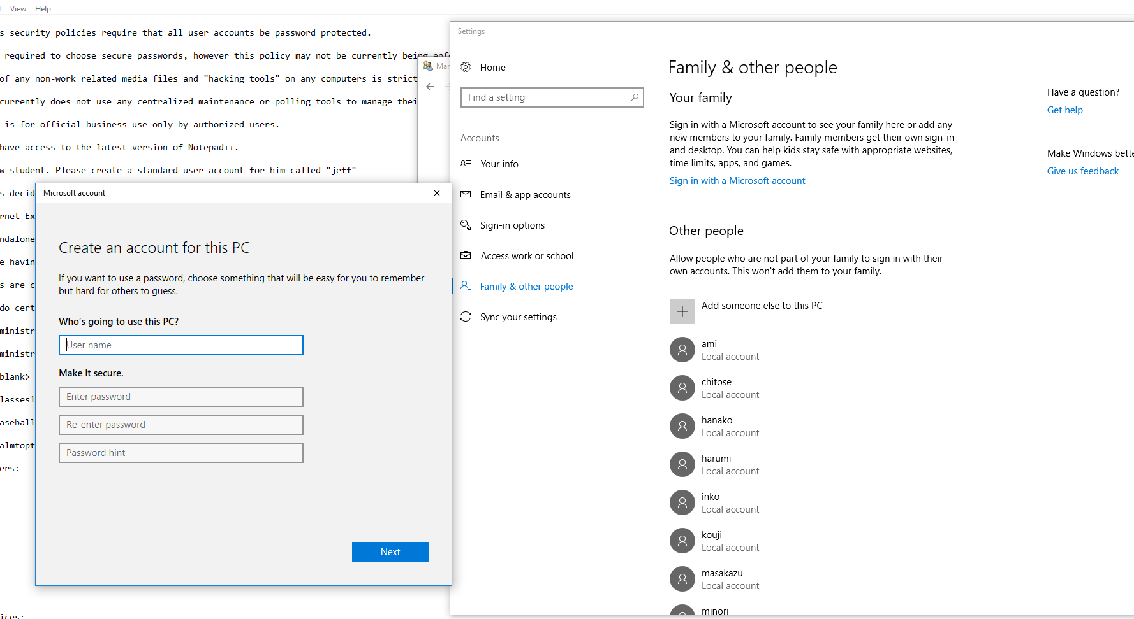
Add Users - Settings
If you need to add a user
Settings - Family/Other people
Also can be used for other user stuff
Enter name and default password

Slide 7
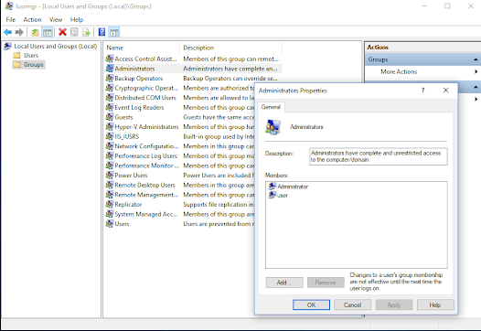
Groups
Right click, “New Group” to create new group
Right click on a group, and go to properties
You can add and remove users from the group
Right click on a group and press “delete” to delete

Slide 8
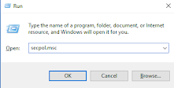
Password policies
Press Windows + r to open the run command
Type in: “secpol.msc”
You can use this to edit security policies and more.
Navigate to Security Settings→Account Policies

Slide 9
Password Policy
Under Password Policy
Password History - 5
Max Age: 90 for users, 30 for admins
Min age: 20 days
Min length: 8
Enable complexity
Disable reversible encryption
Under Account Lockout Policy
Account lockout duration: 30
Account lockout threshold: 5-30
Reset account lockout counter after: 30 minutes
[Just need to set the second, others will automatically set]

Slide 10
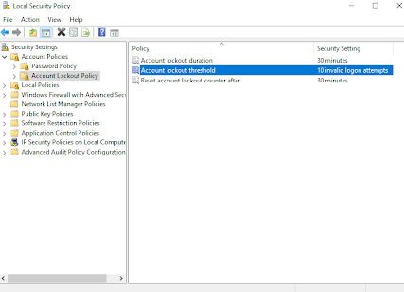
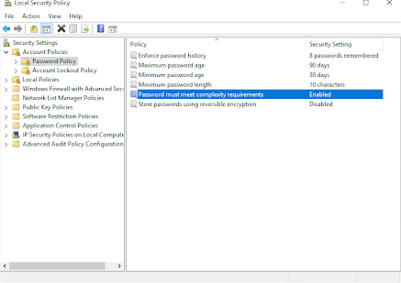

Slide 11
Windows Command Line - Users
Right click on cmd.exe, and click on “Run as administrator.”
Net user is the command relating to managing user accounts
To add a user:
net user /add <user> <password>
To remove a user:
net user <user> /delete
To activate/deactivate a user account:
net user <user> /active:<yes or no>
Create a password:
net user <user> <password>

Slide 12
Windows Command Line - Users and Groups
To manage groups, do the following:
Make “password never expires” false
wmic UserAccount where Name='<user>' set PasswordExpires=True
Remove or make a group
net localgroup /<add or delete> <group>
Add or remove a user from a group
net localgroup <group> <user> /<add or delete>

